Slide 1

Insights From Failed Orders
Made By : Jayesh Wagh

Slide 2
Project Details
Gett is an Israeli developed-technology Platform (App). They have an application where clients can order taxis, and drivers can accept their rides (offers)
In this task, we would like to investigate some matching metrics for orders that did not complete successfully, i.e., the customer didn't end up getting a car.
Analysis Workflow :- Cleaning & EDA → Analysis → Visualization → Presentation
Tools :- SQL :- For data cleaning and EDA
Tableau :- For data visualizations
Power Point :- For making Presentation

Slide 3
Problem Statement
Build up distribution of orders according to reasons for failure: cancellations before and after driver assignment, and reasons for order rejection. Analyze the resulting plot. Which category has the highest number of orders?
Plot the distribution of failed orders by hours. Is there a trend that certain hours have an abnormally high proportion of one category or another? What hours are the biggest fails? How can this be explained?
Plot the average time to cancellation with and without driver, by the hour. If there are any outliers in the data, it would be better to remove them. Can we draw any conclusions from this plot?
Plot the distribution of average ETA (Estimated Time of Arrival) by hours. How can this plot be explained?

Slide 4
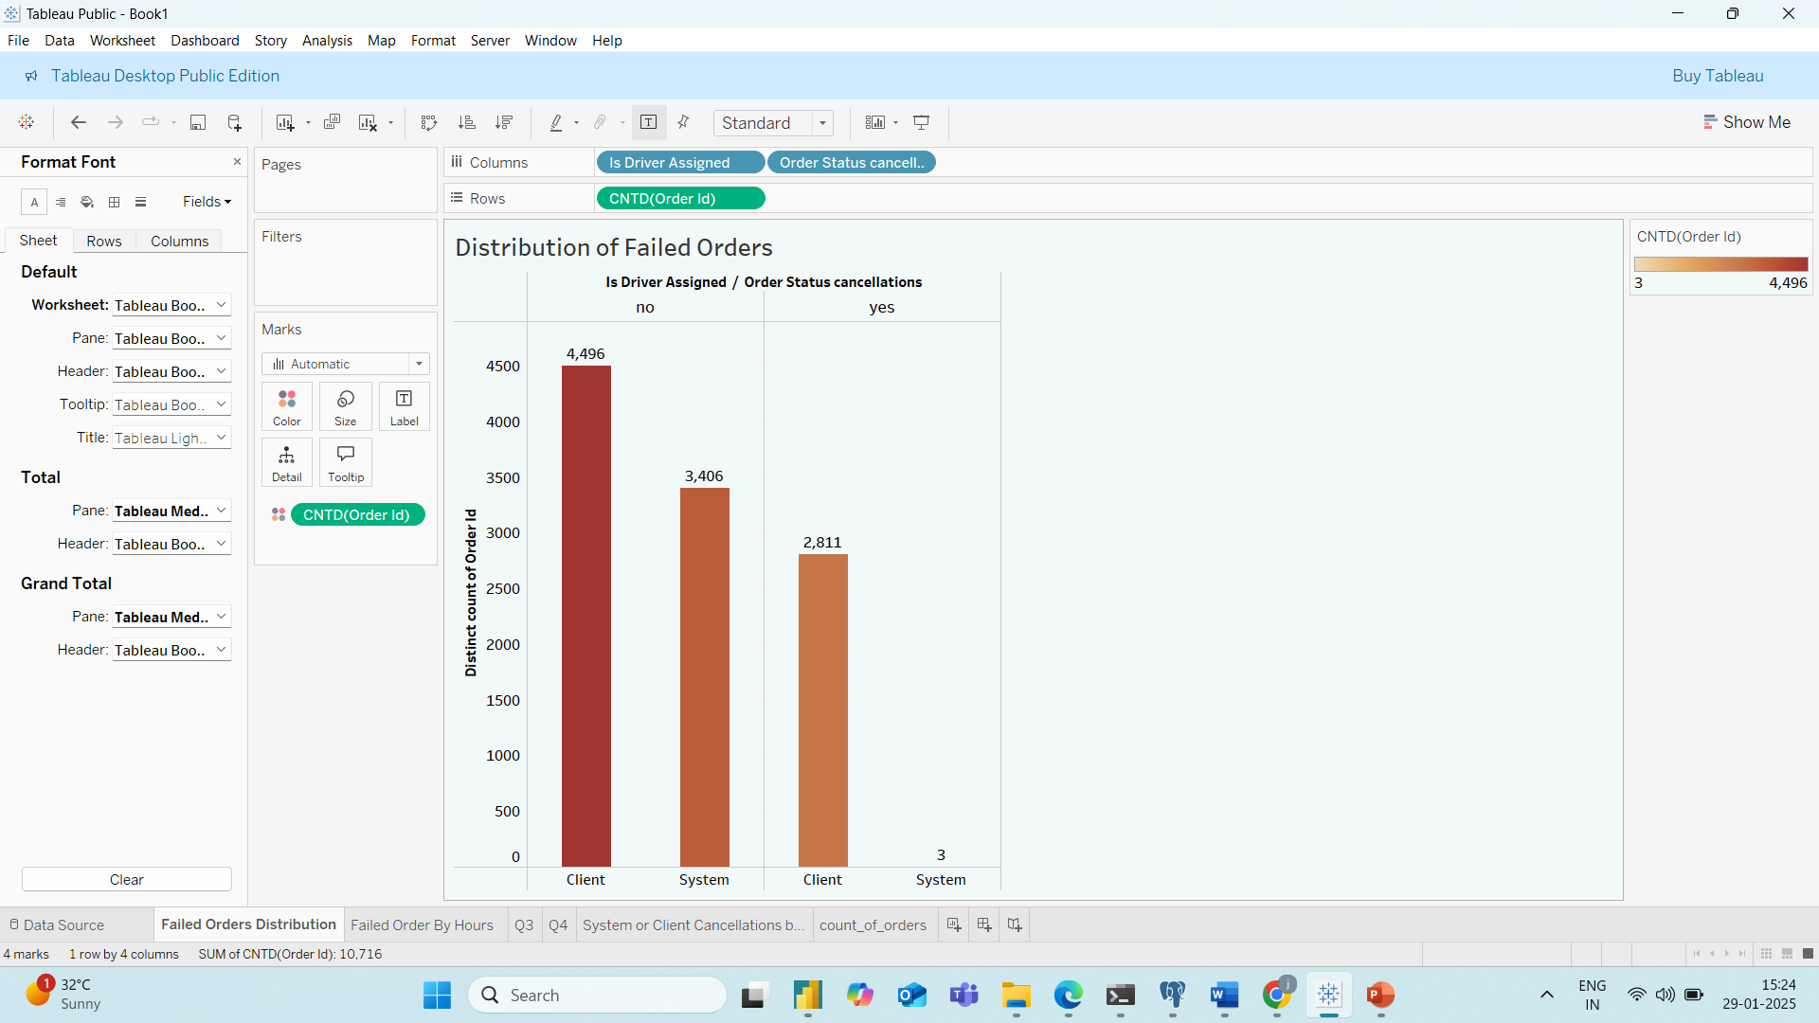
Analysis of Failed Orders
1
74% of failed orders occurred before driver assignment.
Client cancellations: 4,496 orders (Highest)
System cancellations: 3,406 orders
Cancellations after driver assignment (Client-driven): 2,811 orders
Most order failures happen before driver assignment, primarily due to client cancellations.
System-related issues also contribute significantly.
Even after driver assignment, client cancellations remain notable

Slide 5
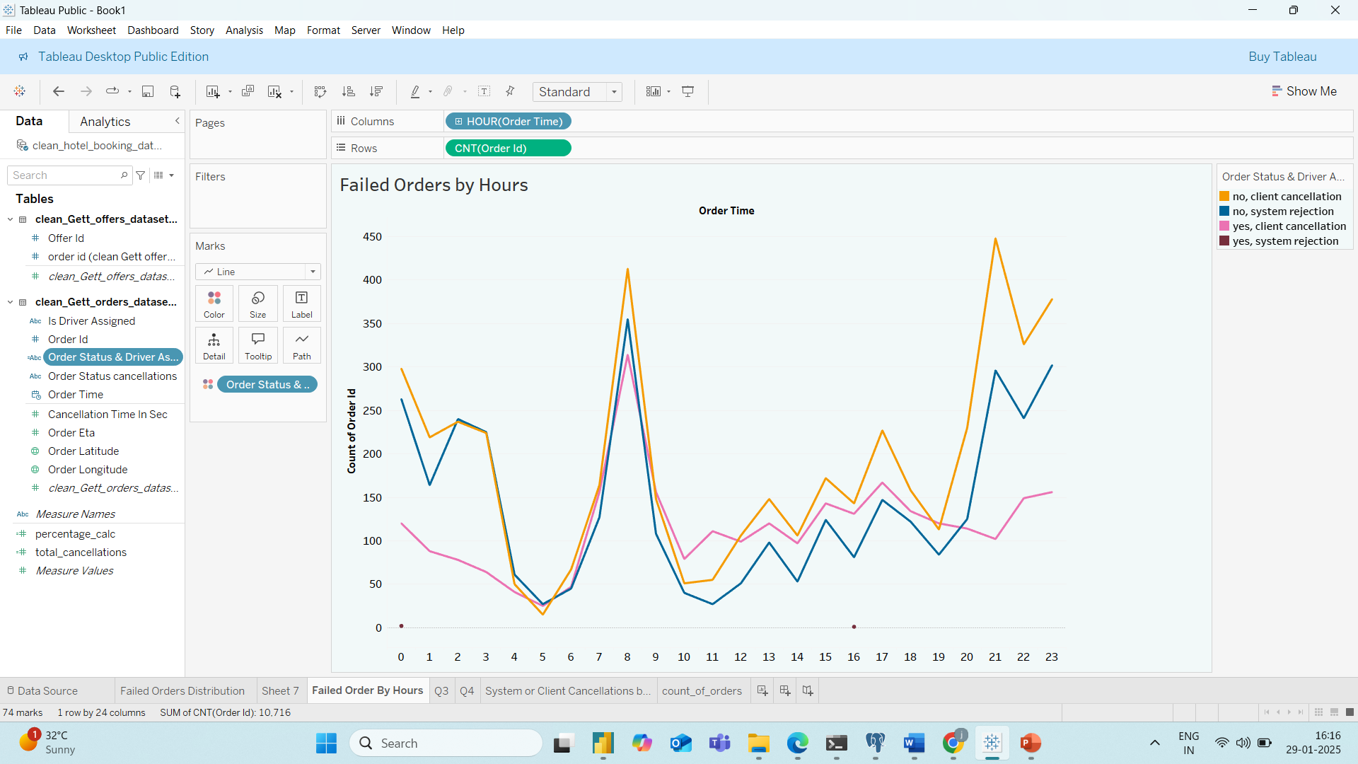
Order Failures by Time of Day
2
Morning Hours (7 AM - 9 AM):
High failure rate across all categories.
Reason: Most people are heading to work, leading to delays (high waiting time for taxi arrival).
Impact: Orders fail even when a driver is assigned due to customer impatience.
Night Hours (9 PM - 1 AM):
High failure rate due to drivers not being assigned.
Reason: Could be due to non-availability of drivers during late-night hours.
Impact: Orders fail because of insufficient driver availability.

Slide 6
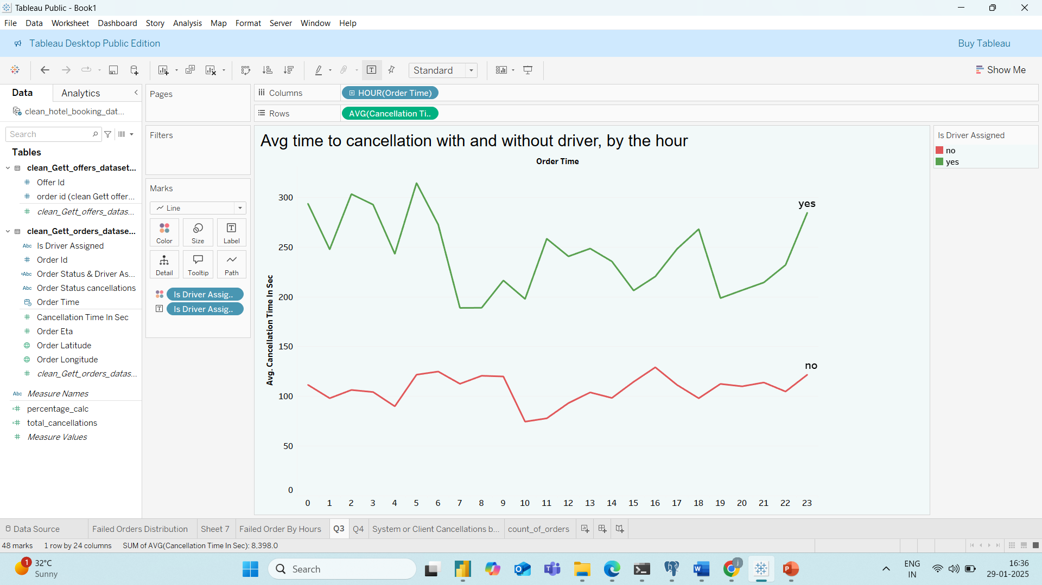
Average Time to Cancellation (By Driver Assignment)
3
Before Driver Assignment:
Average time to cancellation: 2 minutes or less.
Indicates: Customers do not wait long for a driver to be assigned.
Implication: Impatience is observed, as customers cancel quickly if no driver is assigned.
After Driver Assignment:
Average time to cancellation: 3 - 5 minutes.
Reason: Likely due to customers could have find other mode of transportation.

Slide 7
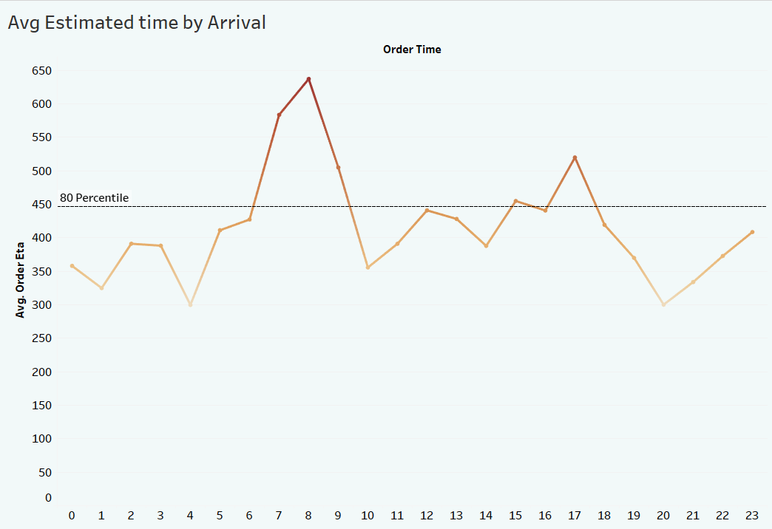
Average Waiting Period By Hours
4
High Average ETA:
Morning Rush (7:00–9:00 AM):
Highest waiting times, peaking at 8:00 AM.
Congestion and demand surge likely slow driver arrival.
Evening (5:00 PM):
Secondary spike in waiting time (likely due to post-work commutes).
80th percentile ETA is close to 8 minutes (446 seconds). indicating that 80% of customers experience wait times under 8 min.
Exception: Morning/evening peaks exceed this threshold

Slide 8
Key Insights
Order Failures: Pre-Assignment Dominance
74% of failures occur before driver assignment.
Client cancellations (4,496 orders): Impatience due to no immediate driver assignment.
System cancellations (3,406 orders): Driver unavailability or app-related issues.
Post-Assignment Cancellations
2,811 client cancellations even after driver assignment : users don’t want to wait or taxi taking time to reach users.
Peak Hour Challenges
Morning Rush (7:00–9:00 AM): High failure rates due to driver shortages + traffic congestion.
Late Night (9:00 PM–1:00 AM): Failures due to driver unavailability.
Cancellation Timing Trends
Before Assignment: Avg. cancellation time ≤ 2 mins → Customers cancel quickly if no driver is assigned. After Assignment: Avg. cancellation time 3–5 mins . Indicating customers do not like to wait, regardless of assignment status.
Morning (7:00–9:00 AM) & Evening (5:00 PM): ETA exceeds 8 minutes (80th percentile threshold).

Slide 9
Recommendation
Optimize Driver Supply :- Peak Hours (7:00–9:00 AM, 5:00 PM):
Incentivize drivers with surge pricing/bonuses to increase availability.
Partner with night-shift drivers for late-night coverage (9:00 PM–1:00 AM).
Dynamic ETA Updates: Use real-time traffic data to adjust ETAs and notify customers of delays.
Driver Prioritization: Assign closest drivers during peak hours to minimize travel time. This will also help to reduce system cancellation.
Investigate system-related issues that contribute to cancellations, especially driver assignment failures, and work on improving the algorithm or process for assigning drivers in a timely manner.
Reward customers who tolerate delays with loyalty points.

Slide 10
Thank You

